Slide 1
Azure Integration Services

Slide 2





Frank Goossen
Software Engineer
frank-goossen
goozdev

Slide 3



Joeri Lieuw
Software Engineer
joeri-lieuw
jlieuw

Slide 4
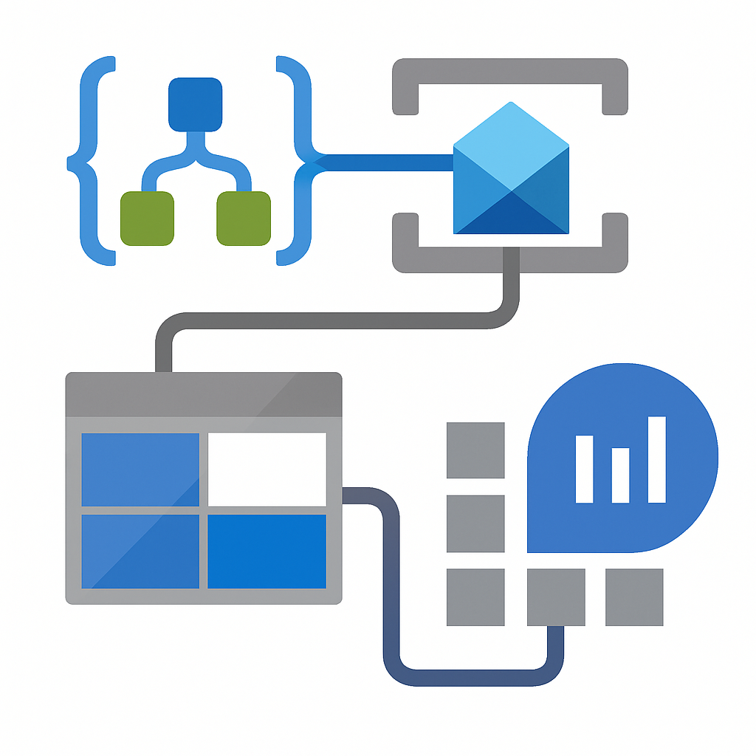
Course overview
Module 1: Intro
Module 2: Logic Apps
Module 3: Service Bus
Module 4: Storage account
Module 5: Log Analytics Workspace

Slide 5
What is Azure Integration Services?
Cloud-native integration platform
Automates workflows and connects systems
Scalable, event-driven and serverless
Notes:
Azure Integration Services is a cloud-native, serverless platform that helps you connect applications and automate workflows across diverse environments—cloud, on-premises, or hybrid. It's fully managed by Microsoft, which means you don’t have to worry about infrastructure, and it scales automatically based on demand. AIS enables event-driven architectures and is a core foundation for test automation, message processing, and system integration in environments like Zeeman.

Slide 6
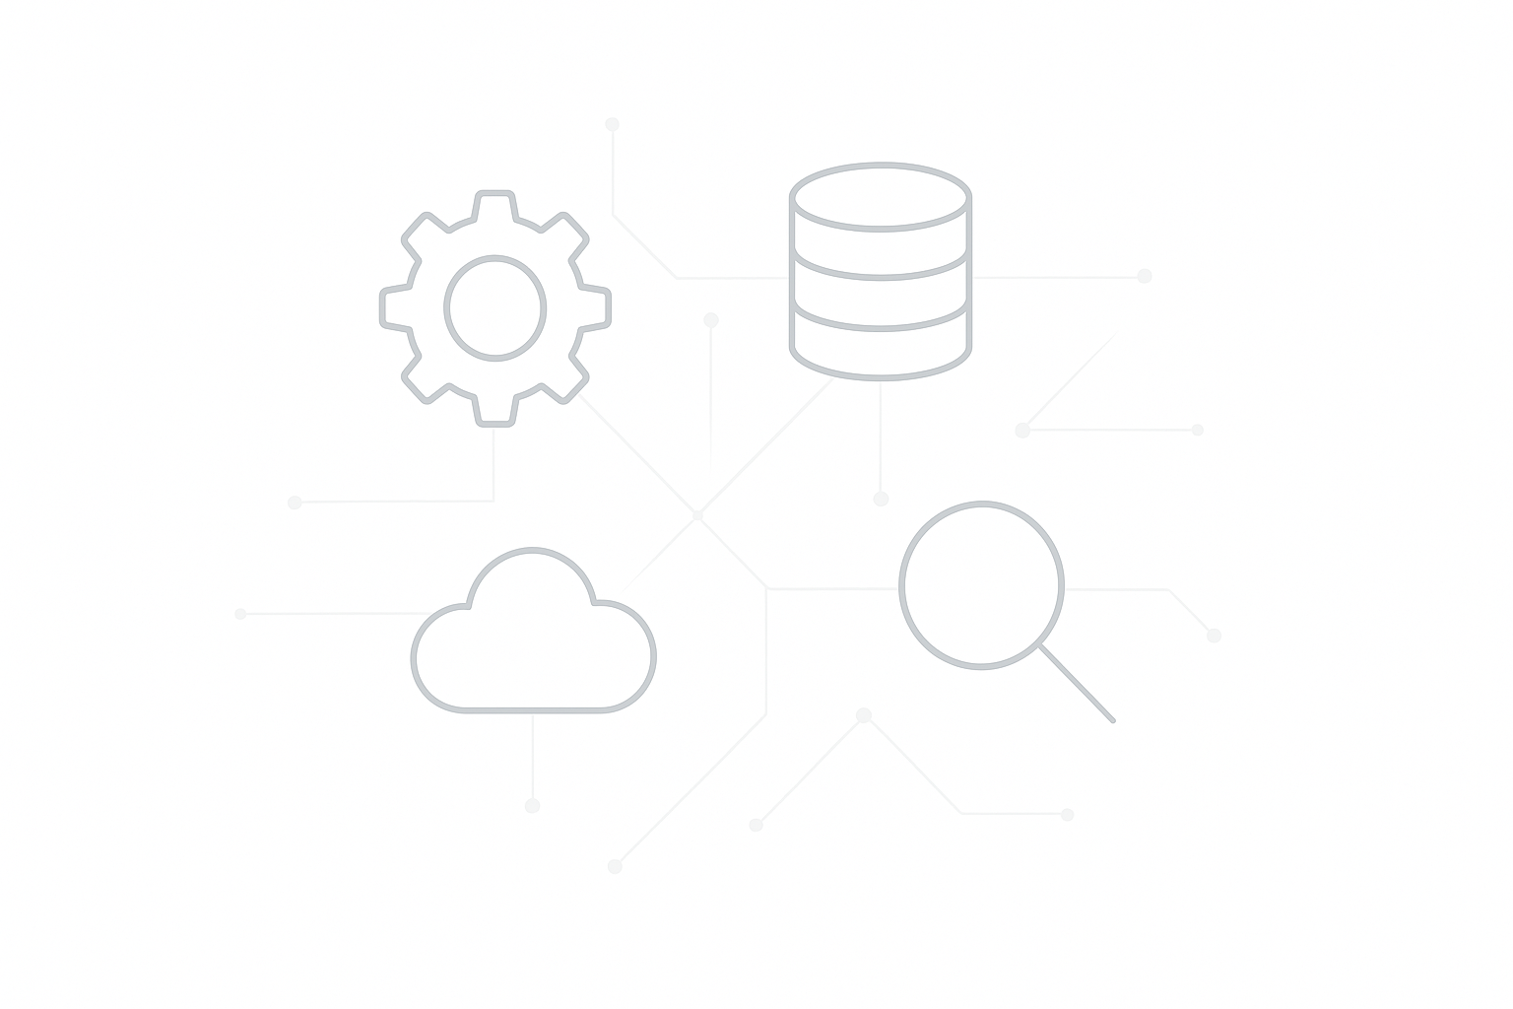
Azure Integration Services: Components
Logic Apps: Orchestration
Service Bus: Messaging
Storage Account: Lightweight storage
Log Analytics: Monitoring
Others:
API Management
Data Factory
Event Grid
Functions
Notes:
Here are the core components of AIS that we’ll focus on today:
Logic Apps are used for orchestration—defining workflows that automate tasks or processes across services.
Service Bus is a message broker, ideal for decoupling systems and enabling asynchronous communication.
Storage Accounts, especially Blob and Queue storage, offer lightweight persistence for files or intermediate data.
Log Analytics provides powerful monitoring and diagnostics, helping us trace executions, failures, and performance issues.

Slide 7
Integration Needs
Hybrid systems integration
Workflow automation
Event-driven processing
End-to-end observability
Notes:
At a lot of companies (like Zeeman) there’s a need to connect (legacy) on-prem systems with modern cloud-native applications. This hybrid landscape requires integration solutions that are flexible, scalable, and easy to monitor.
The four key integration needs we’ll focus on today are:
Hybrid systems integration: Bridging old and new systems.
Workflow automation: Reducing manual work, streamlining test flows and operations.
Event-driven processing: Reacting in real-time to events like http requests or queue messages
End-to-end observability: Giving testers visibility into the full process chain — from trigger to outcome — for better diagnostics and confidence in automation.
These are the needs that Azure Integration Services addresses — and what we’ll explore in the next modules.

Slide 8
Why Event-Driven architecture?
Systems react to events (new order, button click, queue message)
Improves scalability and responsiveness
Reduces coupling between systems
Notes:
A key principle behind AIS is event-driven architecture.
This means systems don’t constantly check each other but instead respond to specific events.
For example: when a new order comes in, it triggers a Logic App.
This improves scalability and keeps systems loosely coupled — a big win in modern integrations.

Slide 9
What is a workflow?
A series of steps that process data or trigger actions
Can span multiple systems or services
Logic Apps allow us to visually define these workflows
Notes:
Before we dive into the tools, let’s clarify the concept of a workflow. A workflow is just a set of connected steps, often across different systems. It could start with an HTTP request, validate input, and end with storing data or sending a notification. In Azure, Logic Apps let you build these workflows using a visual editor — no code needed.

Slide 10
What are Logic Apps?
Low-code workflow automation
Trigger-based execution
Wide integration support
Notes:
Logic Apps is Microsoft’s workflow orchestration tool in Azure, built for automating tasks and integrating systems — all with minimal coding.
You use a drag-and-drop interface to define what should happen when a specific event occurs. These workflows begin with a trigger (such as a file arriving in Blob Storage), followed by one or more actions (like validating the file, sending an email, or storing data in SQL).
Low-code platform for building workflows
Design automated processes using a visual editor
no complex code required.
Trigger-based execution with flexible actions
Workflows are initiated by events (e.g., file upload, HTTP call) and execute a series of steps.
1000+ connectors to various services and systems
Built-in and managed connectors allow seamless integration with systems like Outlook, SQL, SAP, and custom APIs.

Slide 11
Benefits of Logic Apps
Rapid development
Scalable and cost-effective
Resilient and reliable
1,000+ built-in connectors
Notes:
🔧 Rapid development The visual designer makes it fast to build and adjust workflows, even for people without deep coding experience.
📈 Scalable and cost-effective Its serverless model means you only pay when your Logic App runs, and it scales automatically with demand — no infrastructure planning required.
🛡️ Resilient and reliable You also get built-in reliability. Logic Apps come with retry policies and error handling out of the box, which is essential for testers simulating real-world integrations.
🔗 1,000+ built-in connectors And with over 1,000 connectors, you can hook into just about any system Zeeman uses — which dramatically speeds up integration testing and automation.

Slide 12
Triggers and Actions
Triggers
What starts the workflow
HTTP requests
Scheduled intervals (e.g., every hour)
Events from services (e.g., file uploaded, message received)
Actions
What the workflow does
Send emails, store data, call APIs
Perform conditional logic (if/else, switch)
Transform or validate data
Notes:
Logic Apps are based on a trigger-action model.
A trigger is the starting point. It tells the Logic App when to run. This could be:
A scheduled time (e.g., every night at 2am)
An HTTP request, often used in test automation
Or an event, like a file being uploaded to Blob Storage or a message arriving on Service Bus
Once triggered, the Logic App performs a series of actions. These are the actual steps:
Sending an email, writing to a database, calling a REST API, and so on.
You can add logic, like conditions or parallel branches
You can also validate or transform data between steps
This model makes Logic Apps incredibly flexible — and especially useful for building automated test workflows that react to real-world events.

Slide 13

Connectors
Built-in connectors
HTTP, Control, Schedule
Managed connectors
Microsoft & third-party services
Custom connectors
For your own APIs or services
Available by default, no extra setup
Use OpenAPI (Swagger) or Postman collections
Hosted and maintained by MSFT
Notes:
Connectors are how Logic Apps interact with other systems. They abstract away the complexity of authentication, endpoints, and protocols.
There are three main types:
Built-in connectors are always available.
These handle basic operations like HTTP calls, control flow (e.g. "If" statements), and scheduled triggers.
Managed connectors are for integrating with cloud and business apps like Office 365, SQL Server, Salesforce, and others.
These are prebuilt and maintained by Microsoft, and they take care of things like authentication and throttling limits.
Custom connectors let you connect to your own APIs. If you have an internal test platform with a REST interface, you can expose that to Logic Apps using an OpenAPI spec or Postman export.
Using connectors is often as simple as selecting the service and providing credentials. This makes it easy for testers to wire together complex flows without writing boilerplate integration code.

Slide 14
Workflow Design Concepts
Use conditions (if/else, switch) for logic branching
Add parallel branches for concurrent execution
Group steps into scopes for structure and clarity
Loop through arrays using For each
Notes:
Logic Apps gives you a visual canvas to model your workflows clearly and flexibly.
Use conditions like If and Switch to apply branching logic — for example, sending alerts only if a value exceeds a threshold
Parallel branches let you run multiple actions at once — like updating a database while sending a confirmation email
Scopes are containers that group steps logically, especially useful for tracking success/failure as a whole
You can use loops (For each) to iterate through an array — like validating multiple items in a test payload
These concepts help you build clean, modular workflows that are easy to maintain — and easier to debug.

Slide 15
Error handling
Retry policies
Run After
Terminate
Logging
Automatic retries with exponential backoff
Use on scopes/actions to catch Failed, TimedOut, etc.
Explicitly set the Logic App’s final status
Send failures to Azure Monitor, App Insights, or a webhook
Notes:
Logic Apps have built-in error handling, which makes your flows more robust without requiring custom logic.
Each action has configurable retry policies, so transient failures don’t break your flow
The Run After feature lets you chain actions based on the result of a previous step — especially useful for error handling scopes
You can use the Terminate action to exit a workflow early, or return a custom status code — useful for mocking results or enforcing test pass/fail
Finally, use Azure Monitor or your own webhook/API to capture logs — that’s essential for testers to trace what went wrong
Together, these features help build workflows that not only run well — but fail gracefully.

Slide 16
Monitoring Logic Apps
Run History
View each execution: inputs, outputs, duration, and status
Resubmit Failed Runs
Easily re-run failed executions for testing or debugging
Built-in Metrics & Alerts
Use Azure Monitor to track success/failure, run count, latency, etc.
Integration with Log Analytics
Send telemetry to Log Analytics Workspace for deep querying and dashboards
Notes:
Monitoring is essential in Logic Apps — especially for testers.
The Run History gives a detailed timeline for each execution: you can inspect inputs, outputs, errors, and duration per action. Perfect for debugging and validation.
If something fails during a test, you can resubmit that specific run with the same input — great for reproducing and fixing issues.
Logic Apps also exposes metrics to Azure Monitor — like total runs, failed runs, average execution time — and you can use alerts to stay notified about abnormal behavior.
For more advanced monitoring, connect your Logic App to a Log Analytics Workspace. This lets you run queries across all Logic App executions using KQL, and even build custom dashboards.
Together, these features help you track and validate the health of your automated workflows — and trace issues end-to-end.

Slide 17

Lab - Build Your First Logic App
Notes:
In this lab, you'll create your first Logic App. It will be triggered by an HTTP POST request with an order payload. You’ll add a validation step and return a response. We'll build on this foundation in the next modules by storing data and sending messages.

Slide 18
What is Azure Service Bus?
Reliable message broker
Supports decoupled architecture
Ordered, durable delivery
Notes:
Azure Service Bus is a fully managed enterprise messaging system. It enables decoupled communication between microservices or distributed systems by using messages. It's reliable, durable, and supports high-throughput and low-latency messaging scenarios.

Slide 19
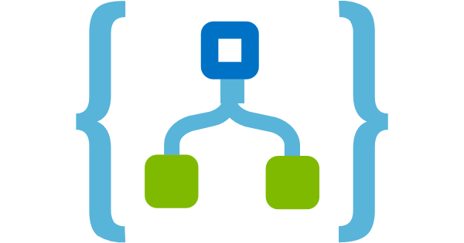

Queues vs. Topics
Sender
Queue
Receiver
Subscription
Receiver 1
Topic
Subscription
Receiver 2
Sender
Subscription
Receiver 3
Notes:
Use queues when you need a one-to-one message exchange pattern — a single consumer processes each message. Topics allow publish-subscribe scenarios, where multiple subscribers receive a copy of each message. This is useful for broadcasting events to multiple consumers.

Slide 20
Dead-letter Queues
Captures undeliverable messages
Used for diagnostics and replay
Notes:
Dead-letter queues store undeliverable messages for later inspection and debugging. For example, if a message can’t be processed after multiple retries or violates validation rules, it ends up in the DLQ. You can manually review and resubmit these messages.

Slide 21
Logic App Integration with Service Bus
Send and receive messages
Use Service Bus connector
Notes:
Logic Apps can connect to Service Bus using built-in connectors to either send or receive messages. This makes it easy to trigger actions based on new messages or notify downstream systems as part of a larger workflow.

Slide 22
Service Bus Security
Shared Access Policies
Role-Based Access Control (RBAC)
Notes:
You can secure Service Bus access using Shared Access Policies (SAS tokens) or Azure RBAC (preferred for managed identity). Always avoid hardcoding keys in Logic Apps — use Azure Key Vault or managed identity whenever possible.

Slide 23
Monitoring Service Bus
Azure Monitor Metrics
Service Bus Explorer
Dead-letter message inspection
Notes:
Use Azure Monitor to track metrics like active messages, dead-lettered messages, and throttle events. Service Bus Explorer in the portal is useful for peeking messages or purging queues. Always monitor DLQs for signs of failure patterns.

Slide 24
Lab - Service Bus Integration
Add Service Bus action to Logic App
Send order notification to queue
Create receiver Logic App to log message
Notes:
In this lab, you'll extend the Logic App to send a message to a Service Bus queue after successfully processing an order. You'll then create a second Logic App to listen to the queue and log the order info. This demonstrates asynchronous, event-driven integration.

Slide 25






Storage Account Overview
Storage Account
File
Queue
Table
Blob
Notes:
Azure Storage offers multiple types of storage:
Blob: unstructured data
Queue: lightweight messaging
Table: NoSQL structured storage
File: file shares for lift-and-shift apps We'll focus on Blob and Queue storage in integration scenarios.

Slide 26
Blob Storage for Integration
Unstructured data storage
Used for storing order payloads
Secure access via SAS or RBAC
Notes:
Use Blob Storage to store files like order payloads, receipts, or logs. Each blob is stored inside a container. You can apply metadata and configure access via SAS tokens or RBAC policies.

Slide 27
Queue Storage Basics
Lightweight messaging
Visibility timeout support
Simple APIs for enqueue/dequeue
Notes:
Queue Storage is a simple FIFO messaging mechanism. Great for lightweight decoupling and passing small message payloads. It supports visibility timeouts and poison message handling (though less advanced than Service Bus).

Slide 28
Logic App Integration with Storage
Upload blobs
Trigger Logic App on blob creation
Notes:
Logic Apps can write to Blob Storage to archive payloads. They can also trigger based on Blob creation events, allowing chained workflows. Queue Storage can be used similarly, but without guaranteed ordering.

Slide 29
Lab - Store Order Payload in Blob
Create Storage Account and Container
Modify Logic App to write blob
Optional: add metadata or enqueue message
Notes:
In this lab, you'll configure your Logic App to write incoming order data into Azure Blob Storage. This simulates archiving or downstream batch processing. Optionally, add metadata or enqueue a message to signal the blob is ready.

Slide 30
What is Log Analytics Workspace?
Centralized monitoring for Azure services
Query and visualize logs and metrics
Notes:
Log Analytics is a centralized monitoring and diagnostics service in Azure. You can collect telemetry from services like Logic Apps, Service Bus, and Storage and query them using Kusto Query Language (KQL).

Slide 31
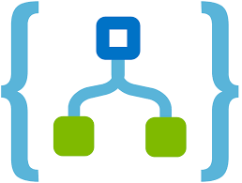


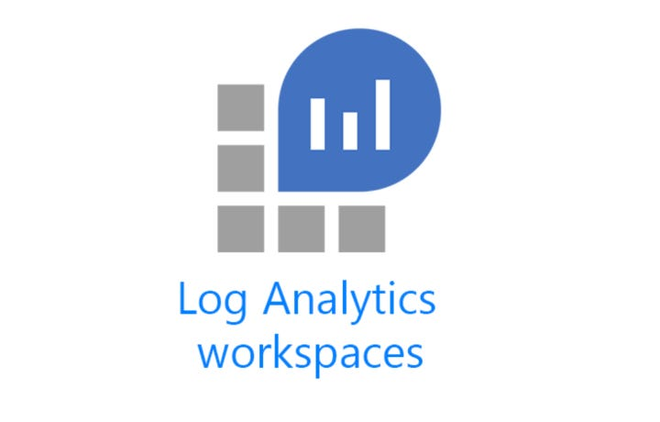





What is Log Analytics Workspace?
Azure Services
Azure Monitor
Alerts
Logic Apps
Dashboards
Service Bus
Diagnostic settings
Log Search
Export
Storage Account
Notes:
Log Analytics is a centralized monitoring and diagnostics service in Azure. You can collect telemetry from services like Logic Apps, Service Bus, and Storage and query them using Kusto Query Language (KQL).

Slide 32
Why Monitor AIS?
Debug Logic Apps
Monitor queue behavior
Ensure SLAs and reliability
Early detection of issues
Notes:
Monitoring ensures visibility into your integrations. You can catch failures, performance issues, and confirm message flows. It’s essential for debugging, alerting, and SLA compliance.

Slide 33
KQL Basics
Use operators: where, project, summarize
Filter and sort by time and attributes
Notes:
KQL (Kusto Query Language) is used to search and filter data in Log Analytics. Key commands include where, project, summarize, and order by. It's similar to SQL but optimized for log data.

Slide 34
Useful KQL Queries
Identify failed Logic App runs
Track message volume over time
Notes:
You’ll learn how to find failed Logic App runs, count Service Bus messages over time, and drill down into specific orders. Example: filter AzureDiagnostics by Status_s == "Failed" to identify errors.

Slide 35
Lab - Monitor with Log Analytics
Enable diagnostics
Query failed runs
Analyze Service Bus messages
Notes:
In the final lab, you'll connect your Logic App and Service Bus to Log Analytics, then write KQL queries to explore failures and message traffic. This reinforces the importance of observability in integration systems.

Slide 36

Questions

Slide 37



www.xprtz.nl
github.com/xprtz
frank@xprtz.net / joeri@xprtz.net

